Slide 1
SUSTAINABLE
DEVELOPMENT
“development that meets the needs and aspirations of the present without compromising the ability of future generations to meet their own needs”

Slide 2

DEVELOPED REGIONS
OF THE WORLD

Slide 3
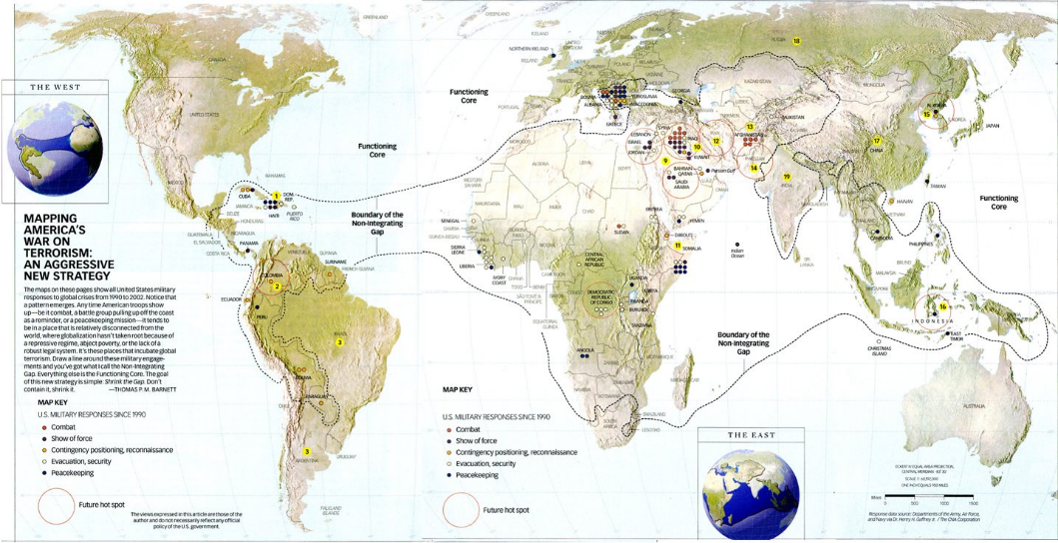
NON-INTEGRATING GAP
THE PENTAGON’S NEW MAP

Slide 4
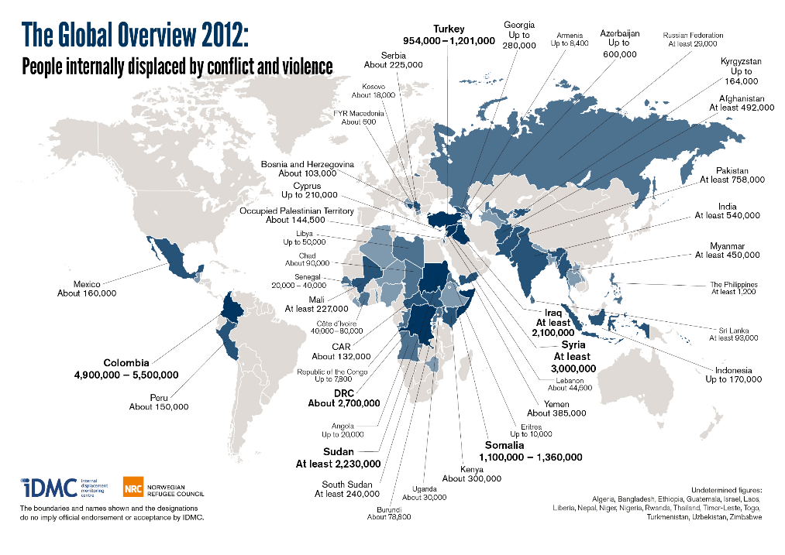
GLOBAL AREAS OF CONFLICT

Slide 5
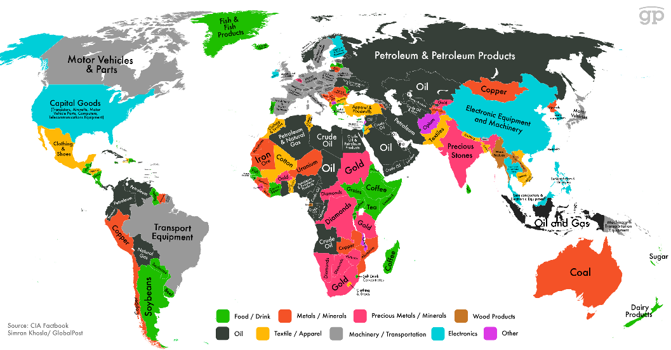
GLOBAL RESOURCES
China
ANTIMONY
BERYLLIUM
FLUORSPAR
GALLIUM
GRAPHITE
GERMANIUM
INDIUM
MAGNESIUM
TUNGSTEN
RARE EARTHS
Canada
COBALT
Mexico
FLUORSPAR
Russia
PLATINUM GROUP METALS
Rwanda
TANTALUM
India
Graphite
United States
BERYLLIUM
Brazil
NIOBIUM
TATALUM
South Africa
PLATINUM GROUP METALS
Democratic Republic of Congo
COBALT
TANTALUM
Japan
INDIUM

Slide 6


INTERNATIONAL
U.S. POLICY IMPLEMENTATION
STABILITY
SECURITY
Diplomacy
Development
Foreign Aid
SUSTAINMENT
Defense
Force Protection
Asymmetrical Warfare
PROSPERITY

Slide 7



Tools
SMART POWER
Challenges and Threats
Wide Spectrum of National Security Challenges
Failed / Failing States and Non-State Actors
Violent Extremism
Rising Powers with Sophisticated Weapons
Threat Response Requires Elevation of Civilian National Security Tools
Geographic Reach
Support and Competency of Global U.S. Government Presence
Economic Growth
Food Security
Health
Climate Change
Government Capacity Building
DEFENSE
“Smart Power” Integrates Civilian and Defense Tools for U.S. National Security Agencies
Engage Partners
Stabilize / Build Host Government Capacity
Prevent New Conflicts
DEFENSE
Base Operations Support Services
Allied Forces
Special Forces
Classified
DEVELOPMENT
DIPLOMACY & DEVELOPMENT
SMART POWER
Infrastructure O&M
Capacity Building
Training
Expeditionary Construction
DIPLOMACY
U.S. Embassies
NGOs
International Agencies
Peacekeeping
U.S. Strategic Objectives Require Forward Operating Presence with Stabilization and
Capacity-Building Capabilities

Slide 8



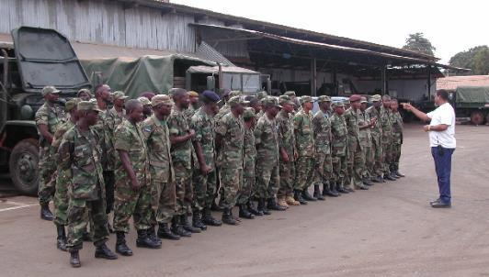
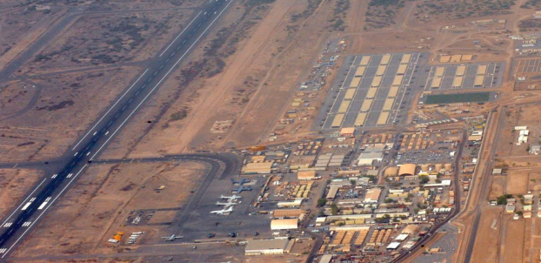
PAE Integrated Solutions
EXTENSIVE DATABASE OF QUALIFIED PERSONNEL
PROVEN TRACK RECORD OF PERFORMANCE
Logistics
Expeditionary Support
Vehicle/ Equipment Management
Life Support/ Sustainment
DEFENSE - DIPLOMACY - DEVELOPMENT -
Facility Management
FULL
LIFE-CYCLE SMART POWER SERVICES
Air Operations
Capacity Building
Construction/ Engineering Services
Institutional Development
Power Generation
EXPERIENCED LEADERSHIP
TEAM
Training
IT / Communications
GLOBAL
PRESENCE
PAE Provides Critical Services along the Full Spectrum of Smart Power Requirements Supporting Policy Implementation for the US Department of Defense and Department of State
PAE Proprietary Information

Slide 9

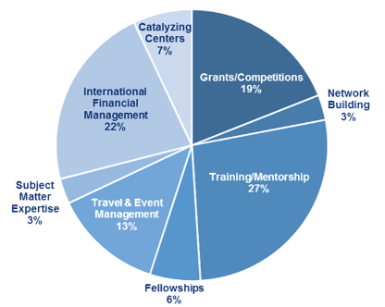
CRDF Global
Promoting safety, security, and sustainability through science and innovation
Non-Profit Public-Private Partnership Promoting International Scientific and Technical Collaboration
CRDF Global Designs Programs, Implements Threat Reduction Missions, Builds Institutions and Capacity, Creates Networks and Develops Relationships, Collaborates Across Borders, Establishes Institutions, and Develops Curricula Through its Eight Core Capabilities.
Today CRDF Global Focuses on Addressing Global Threats in Five Markets
NUCLEAR SECURITY
CHEMICAL SECURITY
BIO SECURITY
GLOBAL HEALTH SECURITY
RESEARCH & INNOVATION
NATURAL SCIENCES
BASIC RESEARCH
APPLIED RESEARCH
TECH COMMERCIALIZATION
ECONOMIC DEVELOPMENT
PROSPERITY

Slide 10
CASE STUDIES
AFRICA
South Sudan
Democratic Republic of the Congo (DRC)
Liberia
CLOSE TO HOME
Haiti / Dominican Republic

Slide 11
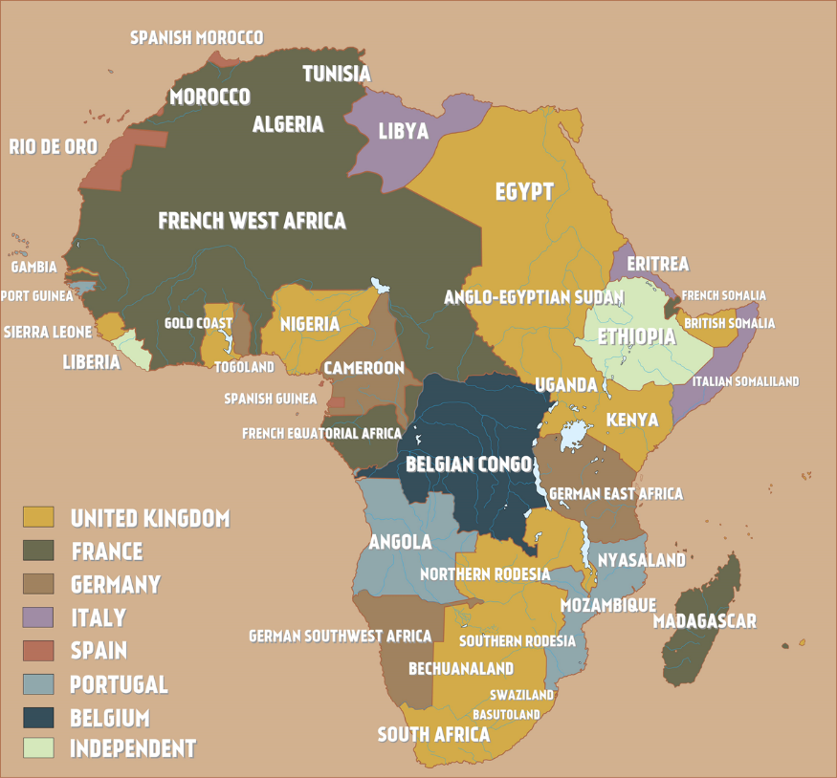
COLONIZATION OF AFRICA

Slide 12
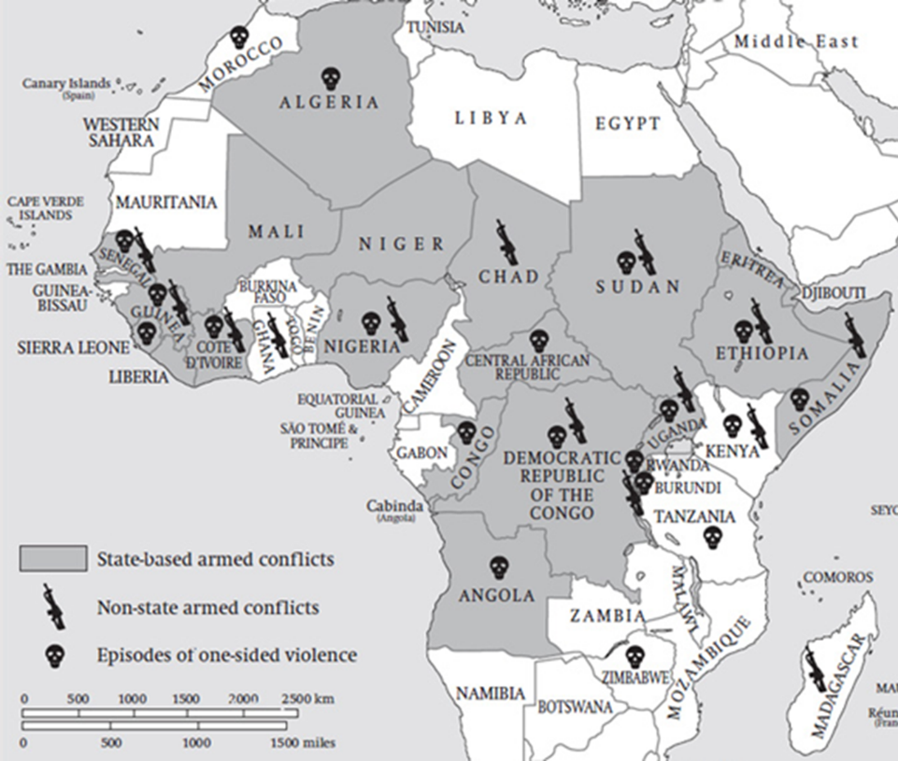
AFRICAN CONFLICTS

Slide 13
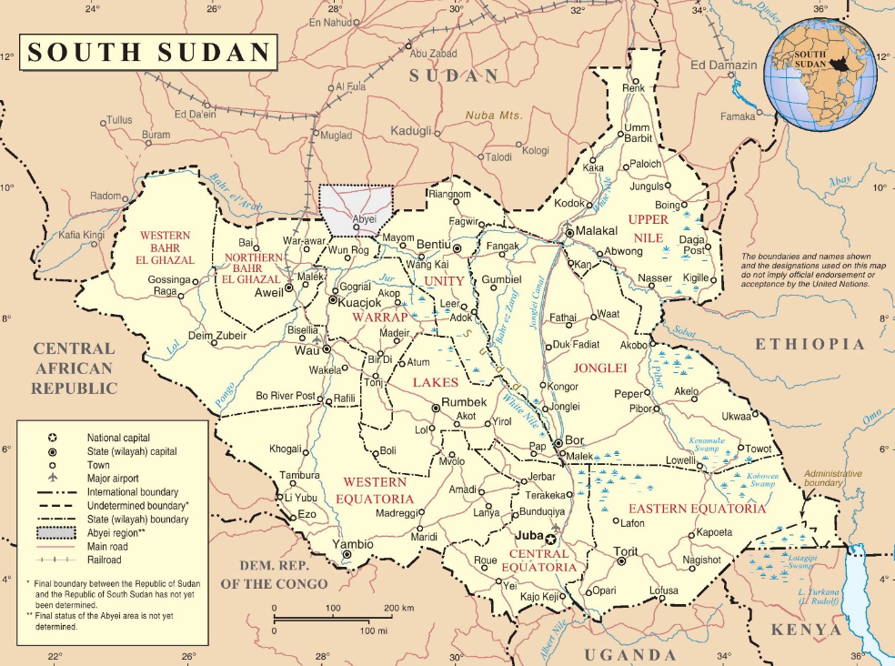

Slide 14
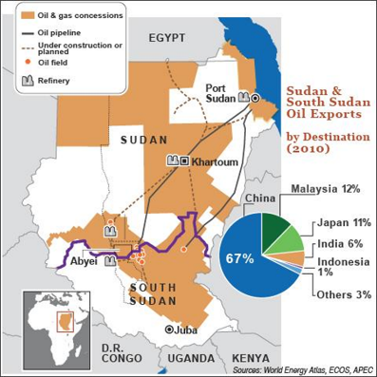

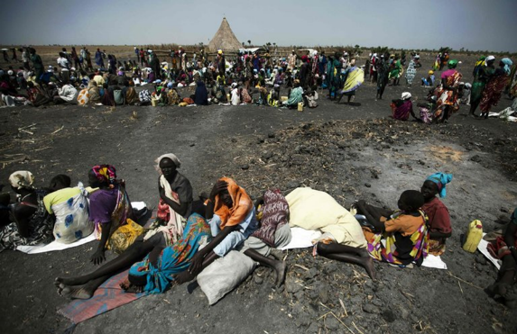

SOUTH SUDAN
Historical Context:
?
?
?
?
US Government Objective:
?
?
?
?
Situation Report:
Genocide
?
?
?
Observations:
?
?
?

Slide 15
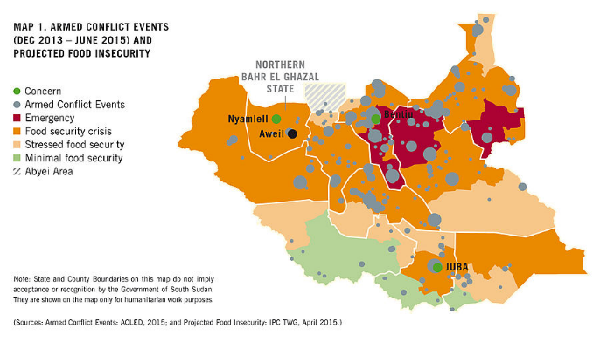
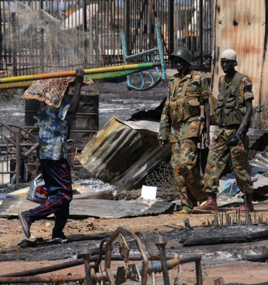

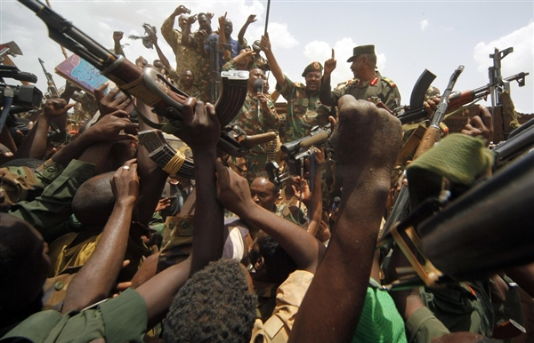
SOUTH SUDAN

Slide 16
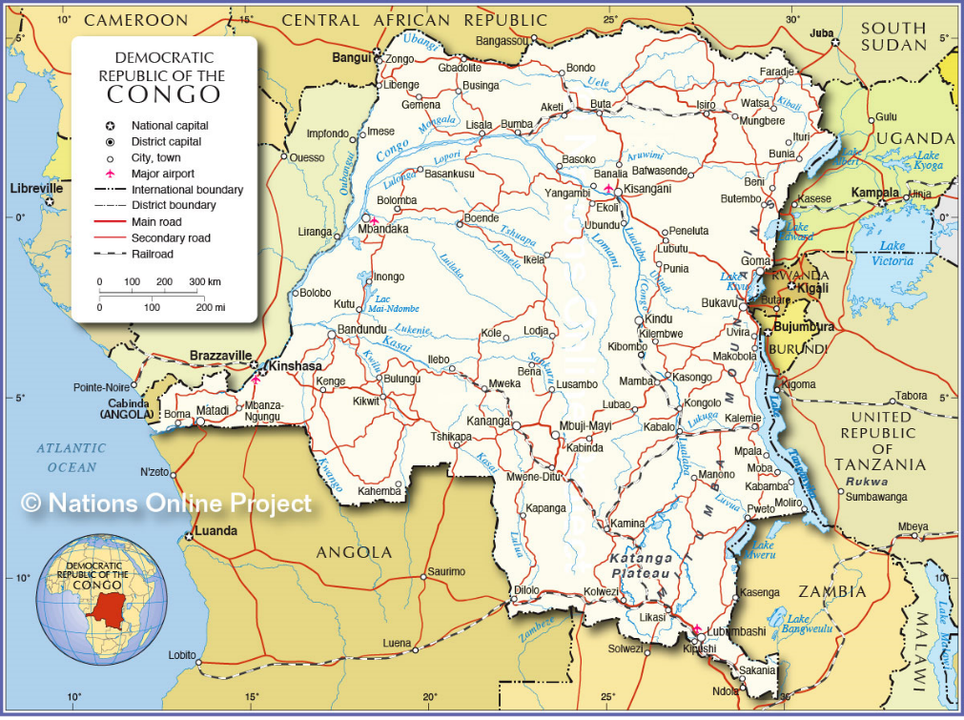

Slide 17
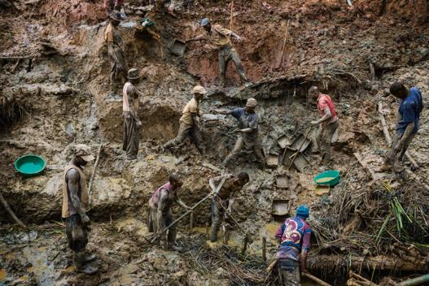
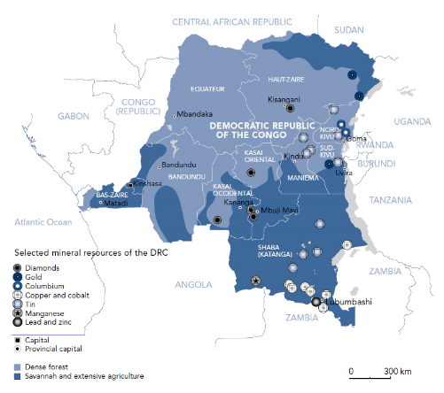
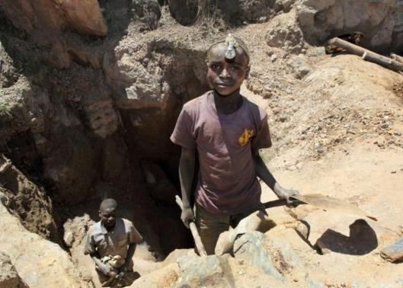
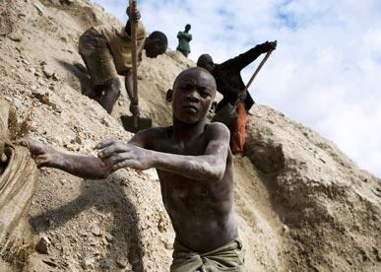
DEMOCRATIC REPUBLIC OF THE CONGO
Hidden cost of mobile phones, computers, and stereos?
“In 1999 and 2000 a sharp increase in the world prices of tantalum occurred, leading to a large increase in Coltan production in eastern Democratic Republic of Congo.
Part of that new production involved rebel groups and unscrupulous business people forcing farmers and their families to leave their land, or chasing people off land where Coltan was found and forcing them to work in artisanal mines.
As a result, the widespread destruction of agriculture and devastating social effects occurred, which in a number of instances were akin to slavery.”
Report of the Panel of Experts on the Illegal Exploitation of Natural Resources and Other Forms of Wealth of the Democratic Republic of the Congo
United Nations Security Council, S/2003/1027, October 28, 2003

Slide 18
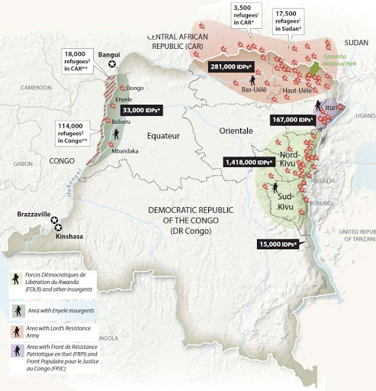

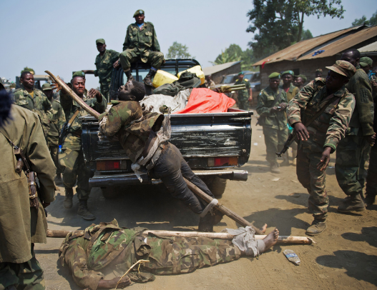
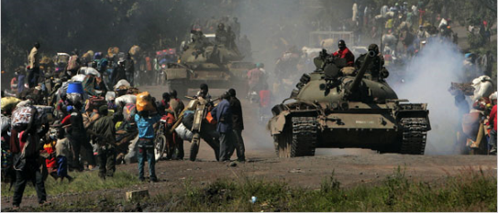
DEMOCRATIC REPUBLIC OF THE CONGO

Slide 19
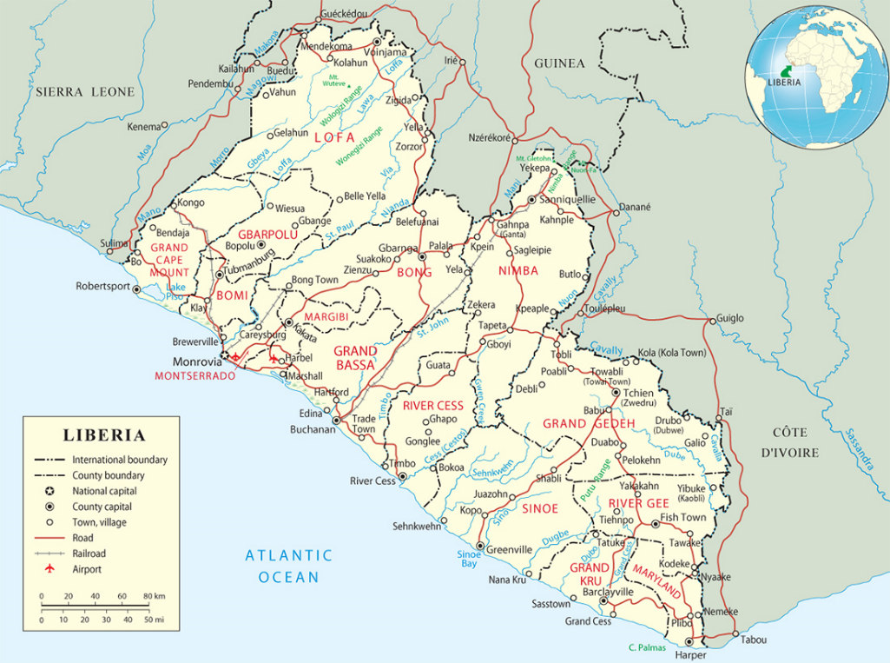

Slide 20



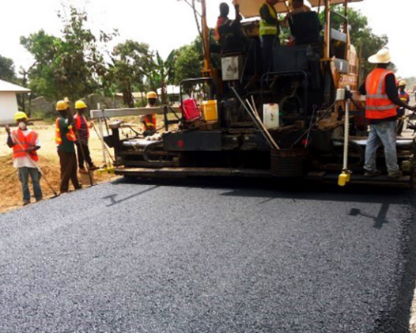

LIBERIA

Slide 21
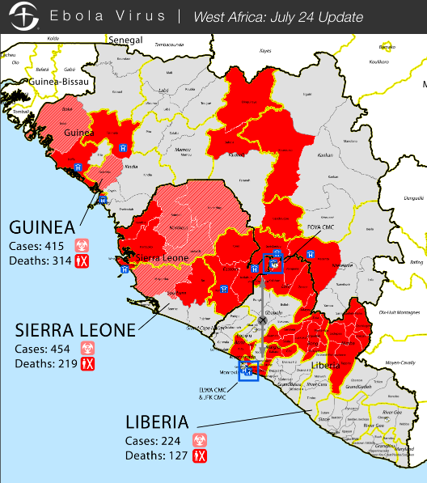
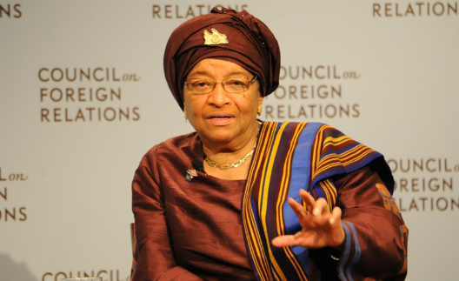
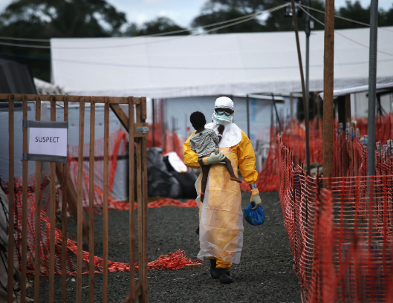
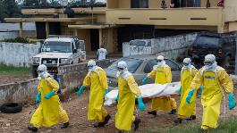
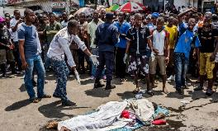
LIBERIA

Slide 22
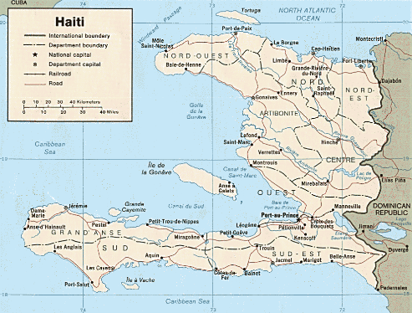
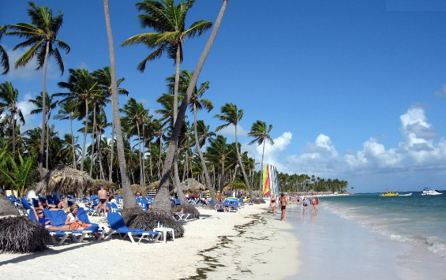
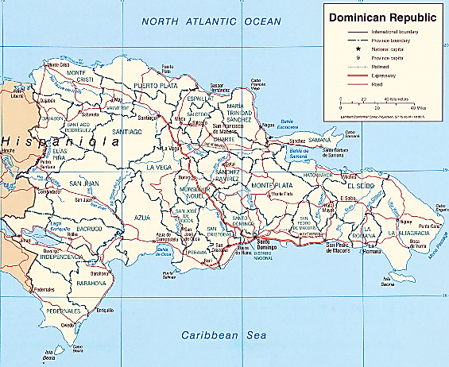
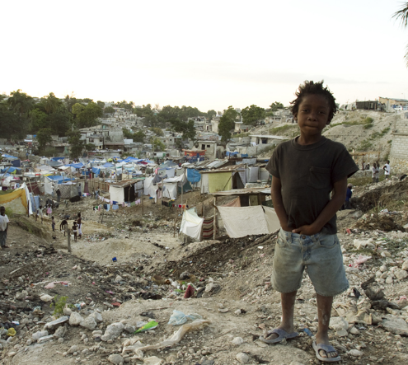
DOMINICAN REPUBLIC
HAITI

Slide 23
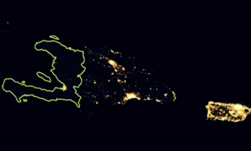

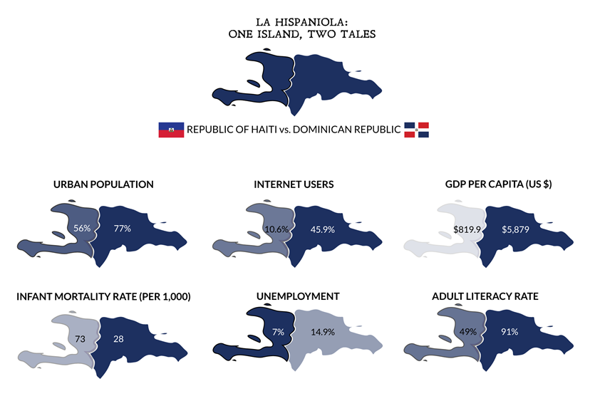
HAITI VS. THE DOMINICAN REPUBLIC

Slide 24
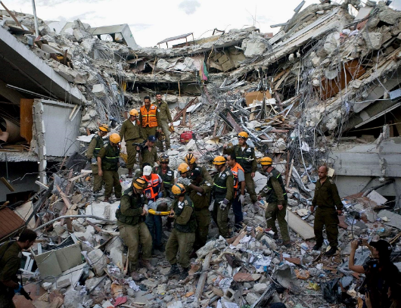
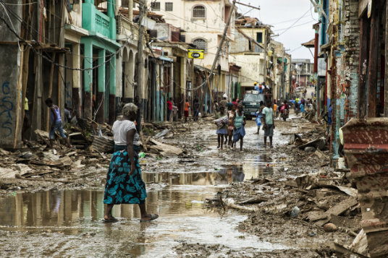
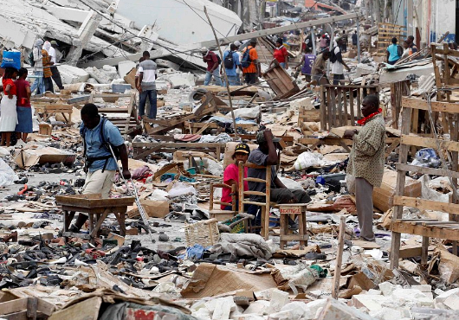
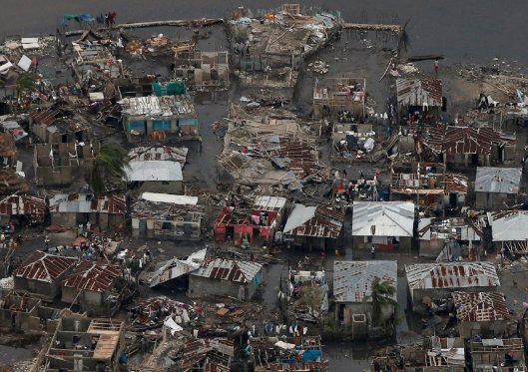
HAITI HURRICANES & EARTHQUAKES

Slide 25
SUSTAINABLE
DEVELOPMENT
QUESTIONS?

Slide 26



Newest Countries Since 1990
YUGOSLAVIA DISSOLVED IN 1990:
Bosnia, Herzegovina, Croatia, Macedonia, Serbia, Montenegro, Slovenia
USSR DISSOLVED IN 1991:
Armenia, Azerbaijan, Belarus, Estonia, Georgia, Kazakhstan, Kyrgyzstan, Latvia, Lithuania, Moldova, Russia, Tajikistan, Turkmenistan, Ukraine, Uzbekistan, Former Yugoslavia
OTHER NEW COUNTRIES
1990 – Namibia, Yemen
1990 – Germany (Unified)
1991 - The Marshall Islands, Micronesia
1993 - The Czech Republic, Slovakia, Eritrea
1994 – Palau
2002 - East Timor (Timor-Leste) UNTAET
2006 – Montenegro, Serbia CIVPOL
2008 – Kosovo CIVPOL / REACT
2011 - South Sudan

Slide 27
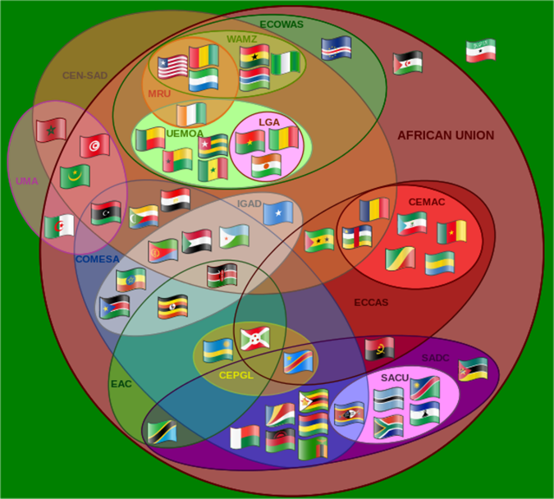
AFRICAN GROUPS
Economic Community Of West African States (ECOWAS)
West African Monetary Zone (WAMZ)
Mano River Union (MRU)
The Community of Sahel-Saharan States (CEN-SAD)
Arab Maghreb Union (UMA)
West African Economic and Monetary Union (UEMOA)
Lagos Accord (LGA)
Intergovernmental Authority on Development (IGAD)
Common Market for Eastern and Southern Africa (COMESA)
The Economic Community of Central African States (Communauté Economique des Etats de l’Afrique Centrale, CEMAC)
The Economic Community of Central African States (ECCAS)
Southern African Development Community (SADC)
Southern African Customs Union (SACU)
Economic Community of Great Lakes Countries (CEPGL)
The East African Community (EAC)

Slide 28

PAE Global Footprint
Current Contract Locations
Prior Contract Locations
PAE has experience in 65 countries with an intimate knowledge of local customs and operating protocols supported with global supply chain and staffing resource management networks.
PAE Proprietary Information

Slide 29
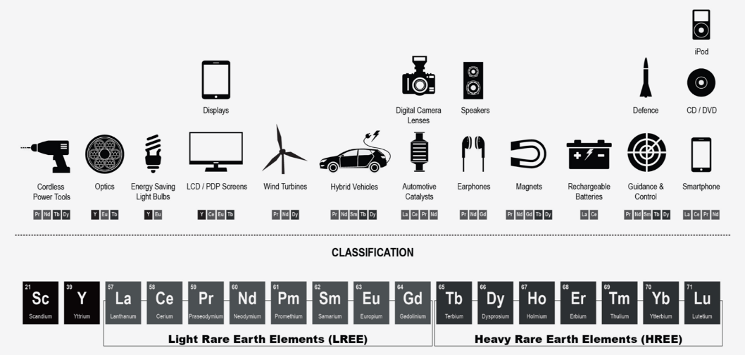
RARE EARTHS
RARE EARTHS
Are Not “Rare” but Rather Extremely Difficult to Extract.
China Holds 95% of the World’s Supply.
In 2010, China Lowered Quotas Causing a Global Crises.
RESOURCE CURSE
Corruption (Public and Private Officials)
Volatility of Single Product Reliance
Natural Resources Do Not Create Jobs In and Of Themselves (Dutch Disease)

Slide 30

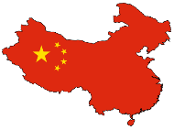
U.S. vs. CHINA - AFRICA POLICY
Africa is Least Developed and Poorest Continent
Africa is Positioned for Massive Growth
Africa is Flush with Highly Desirable Natural Resources
UNITED STATES INTERESTS
Pro-Active Focus on Military and Political
In 2008 Established U.S. Africa Command
Major Base in Djibouti
Troops from Mali in the West through Central African Republic, Ethiopia into Somalia
2011 Intervention into Libya
Intervention into Governments and Human Rights
$85 Billion in Trade
Less Than 100K American Workers
Supporting Northern Fight Against Boko Haram in Nigeria
CHINA INTERESTS
Pro-Active Focus on Economics
Soldiers Only in UN Peacekeeping Missions
Infrastructure Development Primarily to Extract Resources
Non-Intervention Policy
$200 Billion in Trade
Over 1M Chinese Workers
Staying in Southern Oil Producing Region of Nigeria
Mutual Interest in Stability, Resources & Economic Development

Slide 31
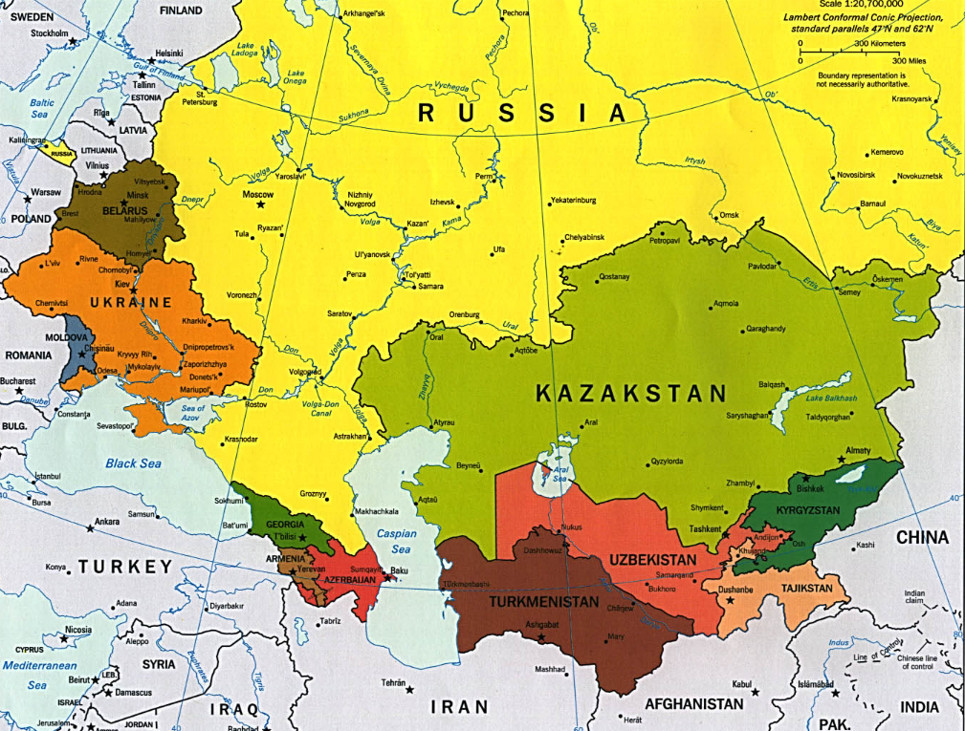

Slide 32



SECURITY/STABILITY
GOVERNANCE
U.S. Civilian Research and Development Foundation for the Independent States of the Former Soviet Union (CRDF)
Rapid Expert Assistance and Cooperation Teams (REACT)
Authorized by US Congress in 1992 Under the Freedom Support Act and Established in 1995 by the National Science Foundation
The Former Soviet Union (FSU) Employed 50K-60K Nuclear Experts, 65K Bioweapons Experts, and 6K Chemical Weapons Experts - Scientist Redirection and Engagement
Defense to Civilian Focus – Collaboration on Research and Development
Establishment of a Market Economy –Between United States Businesses and Scientists, Engineers, and Entrepreneurs in the Newly Independent States
Access for United States Businesses to Sophisticated New Technologies, Talented Researchers, and Potential New Markets
Organization for Security and Co-Operation in Europe
Provides Personnel and Related Personnel Support Services to Rapidly Deploy U.S. Citizens on Behalf of The U.S. Department of State to Advance:
Democratization,
Elections,
Human Rights, and
Rule Of Law
The Organization for Security and Cooperation In Europe (OSCE) In:
Central Asia,
The Caucasus,
The Balkans, and
Central And Eastern Europe

